Slide 1


GAN-generated Faces Detection: A Survey and New Perspective
Written bu: Xin Wang, Hui Guo, Shu Hu, Ming-Ching Chang, Siwei Lyu
Presented by:
Humayra Musarrat
ID: 20101089
Group: 06

Slide 2
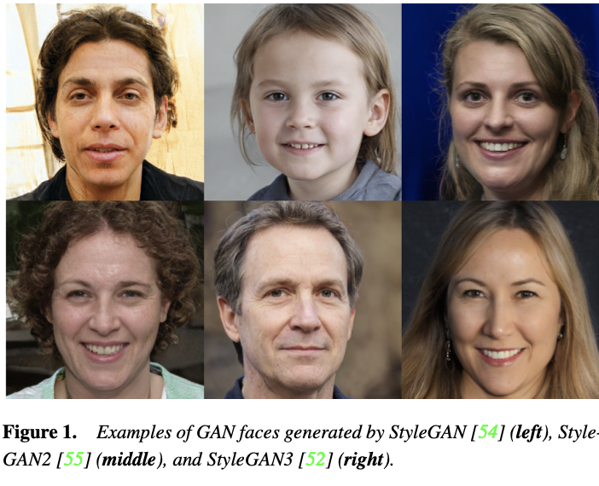
MOTIVATION
Aim of the Paper
01
Motivation
02
Robust Detection Methods
03
Comprehensive review of recent advancements in GAN-face detection.
Increasing use of GAN-generated faces and recognition of societal concerns.
Recognition of the need for robust GAN-face detection methods.

Slide 3
CONTRIBUTION
01
Deep-Learning based
02
Physical based
03
Physiological
based
04
Human visual performance evaluation

Slide 4
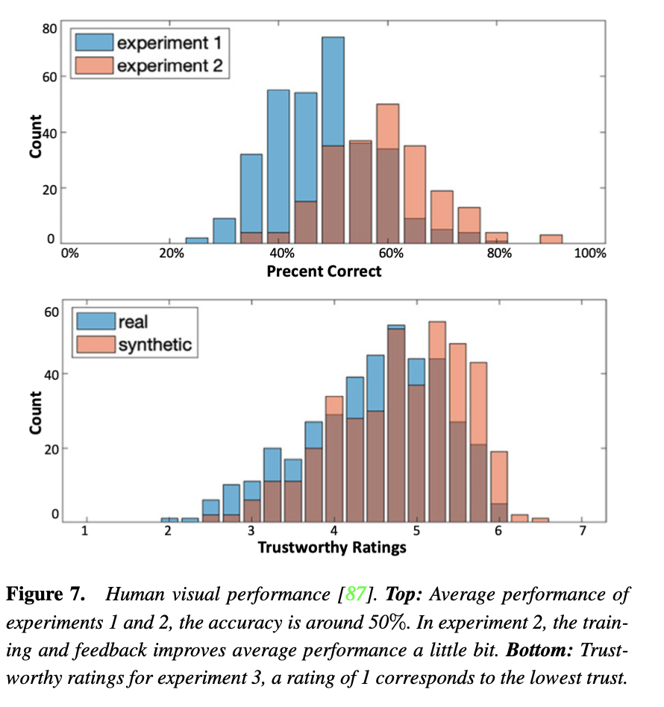
HUMAN VISUAL PERFORMANCE EVALUATION

Slide 5
CONTRIBUTION
Novel physiological-based method focusing on irregular pupil shapes in GAN-generated faces

Slide 6
METHODOLOGY
1
2
3
Discussion on the importance of understanding human perceptual challenges in distinguishing GAN-generated faces.
Chronological Summary of GAN-face Generation Milestones
Emphasizes the evolution of GAN models from 2014 to recent advancements like StyleGAN3

Slide 7
FIRST LIMITATION
Subjectivity in method selection and categorization
Acknowledged potential biases.
Suggested more detailed discussion.
Emphasis on explicit selection criteria.
Clearer understanding through granularity.

Slide 8
SECOND LIMITATION
Absence of a standardized evaluation framework.
Needs a more thorough exploration of challenges.
Involves varying degrees of complexity in GAN models but the lack of a standardized approach to evaluate the performance of detection methods across this spectrum.

Slide 9
SYNTHESIS
Importance for Practical Applications
Comprehensive Roadmap for Future Research
Development of Robust Detection Methods
Identification of Specific Areas for Improvement
Refined Understanding of Challenges
Implications for Face Morphing and Swapping
Relevance Across Diverse Domains

Slide 10
CONCLUSION
Summary of the paper's thoroughness in addressing challenges and potential future research directions in GAN-face detection. Emphasis on the significance of the paper's findings regarding GAN-generated faces and their implications for human visual performance.

Slide 11
THANK
YOU!!!

